Slide 1


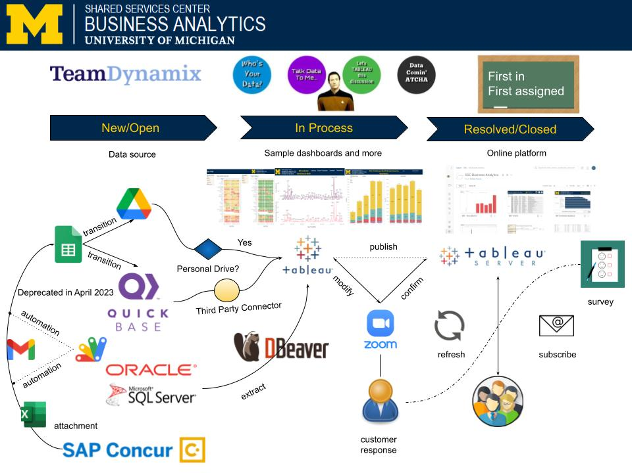
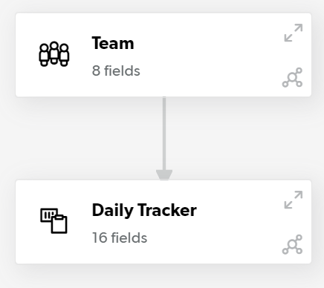
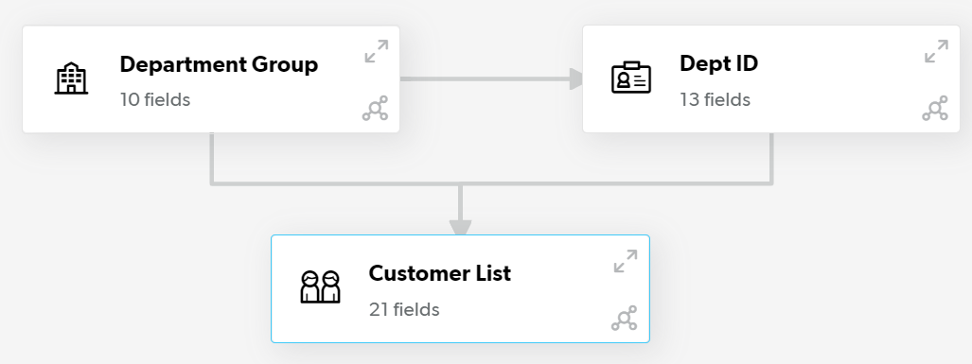
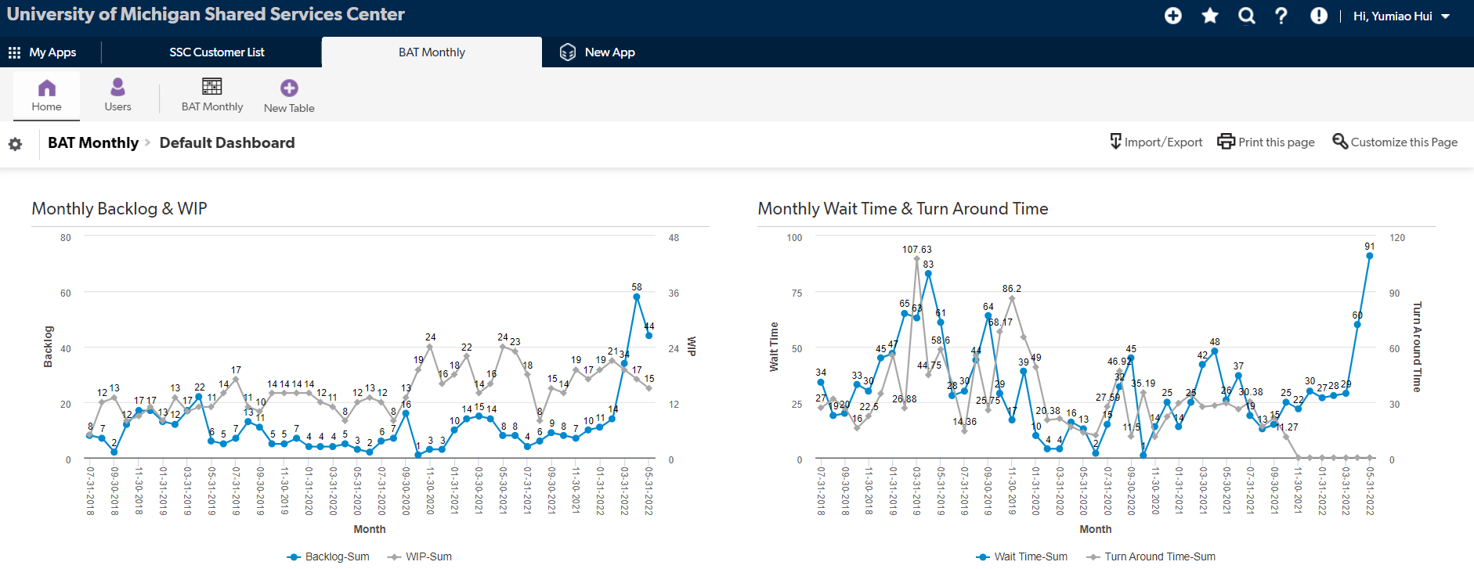
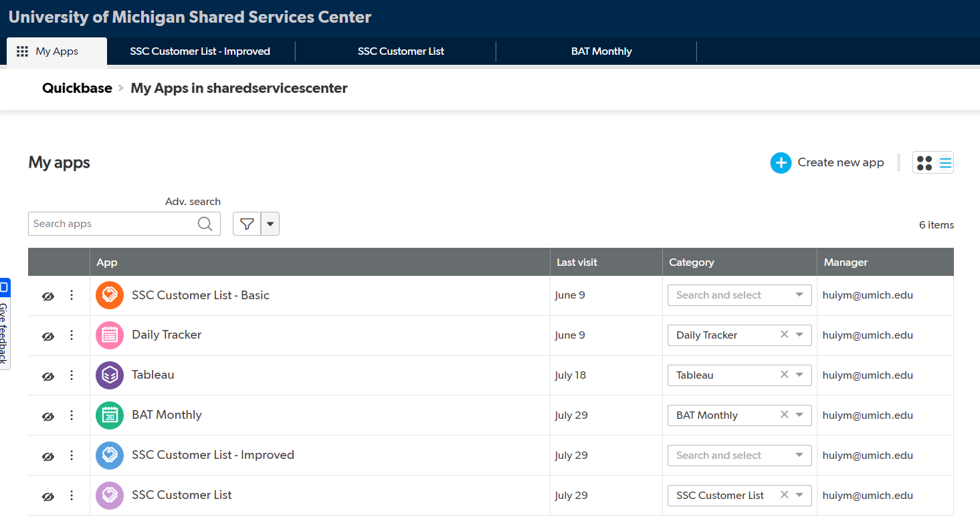

INTERNSHIP
Problem
Showcase
The Google Sheet connector to Tableau will be fully deprecated in April 2023, the BAT Team needs to find a more robust solution. Besides, many manual tasks in BAT would be well suited to automation.
Shared Data Source Platform for SSC Business Analysis
Methods
Created 3 QuickBase applications for each Google sheet file: BAT Metrics, Daily Tracker, and Customer List.
Merged 100 sheets into a single sheet for Daily Tracker and imported them to QuickBase.
Built various tables-to-table relationships.
Generated visualizations for QuickBase.
Coded with Google Scripts for automation.
Results
100% of Google Sheet data is moved to and available in the new tool QuickBase.
2/3 of QuickBase applications are primarily approved after the BAT team discussion:
BAT Metrics & Customer List: Yes!
Daily Tracker: 38 teams’ access control
100% of the steps transferring Concur Intelligence data in Gmail to Google Sheet in Team Drive are automatic.
Solved the problem that Tableau can not directly connect to Team Drive.
SSC BAT Workflow
Scan here to contact us or learn more about SSC Business Analysis
Yumiao Hui
SSC QuickBase Website

Slide 2
